Slide 1
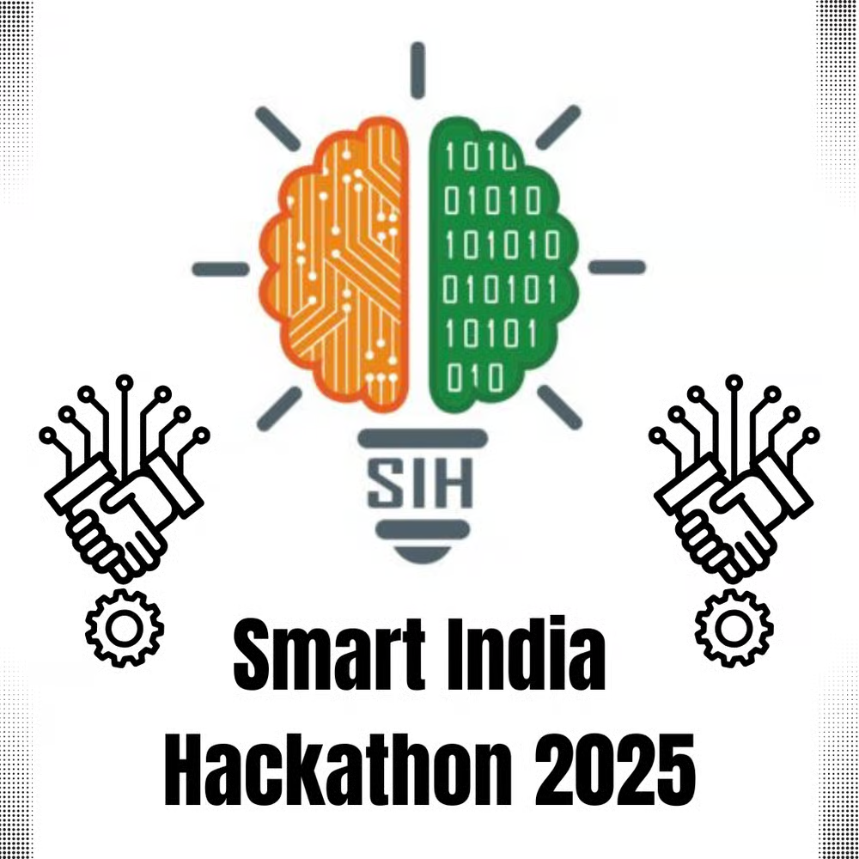
Tech that stops death before the drop
BLUE SHIELD
PROBLEM STATEMENT ID - SIH25001
PROBLEM STATEMENT TITLE -
SMART COMMUNITY HEALTH MONITORING AND EARLY WARNING SYSTEM FOR WATER-BORNE DISEASES IN RURAL NORTHEAST INDIA
THEME - MEDTECH/BIOTECH/HEALTHTECH
PS CATEGORY - SOFTWARE
Mentor: Dr. Varsha
Team Members-Anjasa, Adishree, Sreya, Tanishka, Charis, Jayashri

Slide 2
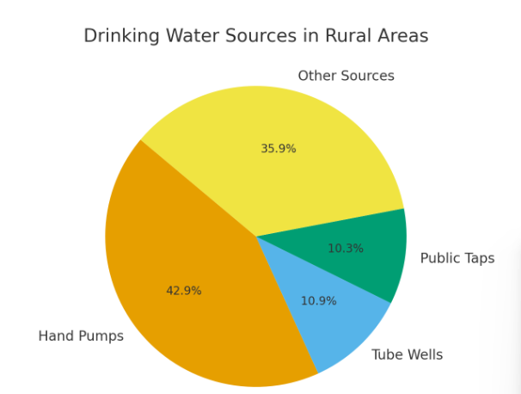
DIGITAL HEALTH PLATFORM
TARGET AUDIENCE-
-Health care workers
-Asha workers
-Volunteers
-Vulnerable communities and tribes of rural north east
To detect and prevent water-borne disease outbreaks by using sensors and an app/SMS system that monitors water quality and alerts people in real time.
Pressing issue in Rural Northeast due to-
-Reliance of available water bodies and traditional hand pumps
- Seasonal floods and poor sanitation
-Weak healthcare access and connectivity
-Late lab results
PROPOSED SOLUTION
Building a proactive surveillance and alert system that collects data from multiple sources such as user-friendly app, sms and IVR platform ,IoT’s and affordable test kits.

Slide 3
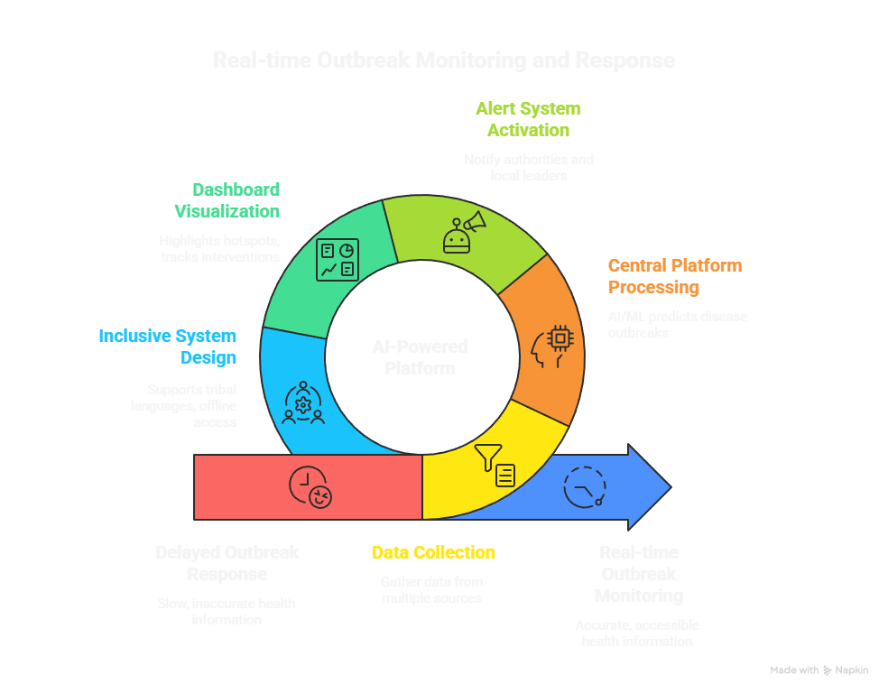
TECHNICAL APPROACH
Technology Stack:
Frontend:
React with TypeScript (all components are .tsx files)
Tailwind CSS v4 for styling (as seen in your globals.css)
shadcn/ui component library for UI components
Backend:
TypeScript running on Deno (Supabase Edge Functions)
Hono web framework for the server API
Supabase for database, authentication, and storage

Slide 4

LIST OF SENSORS USED
For physical factors
Chemical Contamination Sensors-(Chlorine,Nitrate,Lead, Mercury, Arsenic, Cadmium,Fluoride)
Biological Contamination Sensors
Specialized / Smart Sensors

Slide 5
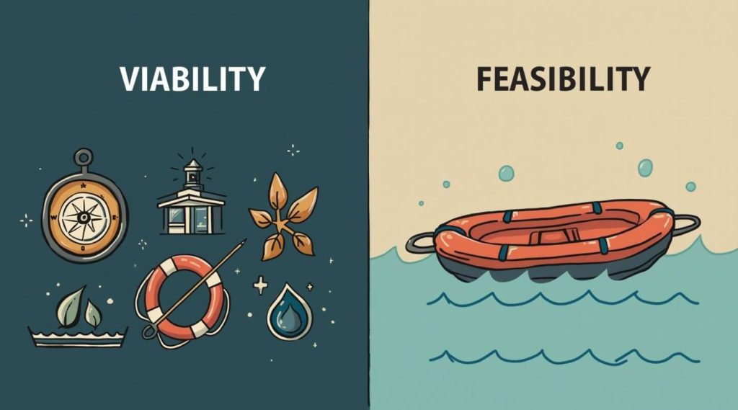
FEASIBILITY AND VIABILITY
TECHNICAL CHALLENGES-
FEASIBILITY
-How can you ensure sustainability?
-What if there is physical damage on sensors?
-Accuracy?
Technical Feasibility
Built on proven tech: IoT sensors, mobile apps, SMS & IVR.
AI/ML engine enables real-time outbreak prediction.
Economic Feasibility
Lower cost than manual lab testing and late-stage treatment.
Uses existing mobile/SMS infrastructure, reducing setup costs.
STRATEGIES TO OVERCOME-
-Sustainability depends on the quality of the sensor
-The app and the main platform will notify the malfunctioning .
-Assumption that the sensor provides the right information

Slide 6
IMPACTS AND BENEFITS
IMPACTS
Faster and cheaper
Inclusive access through SMS/IVR
Empowers Health Workers
Healthier communities
BENEFITS
Real-time updates
Multi-source data collection
Support for tribal/local languages
Seamless communication
Scalable system

Slide 7
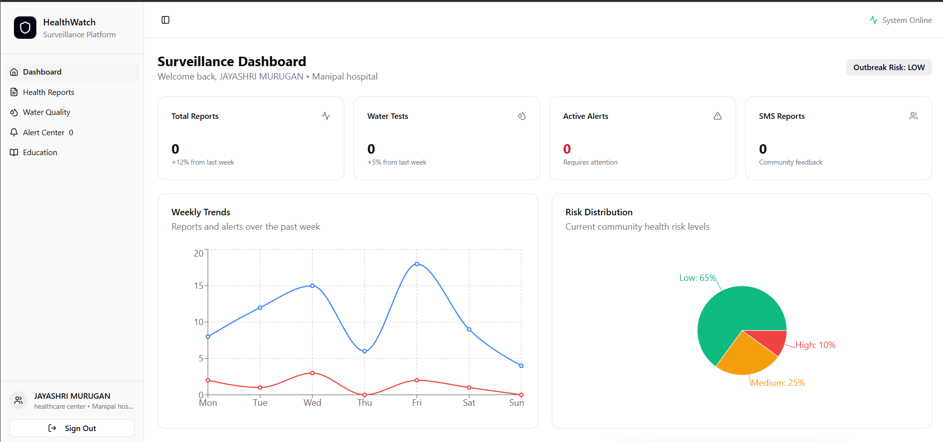
USER INTERFACE
MAIN PLATFORM

Slide 8
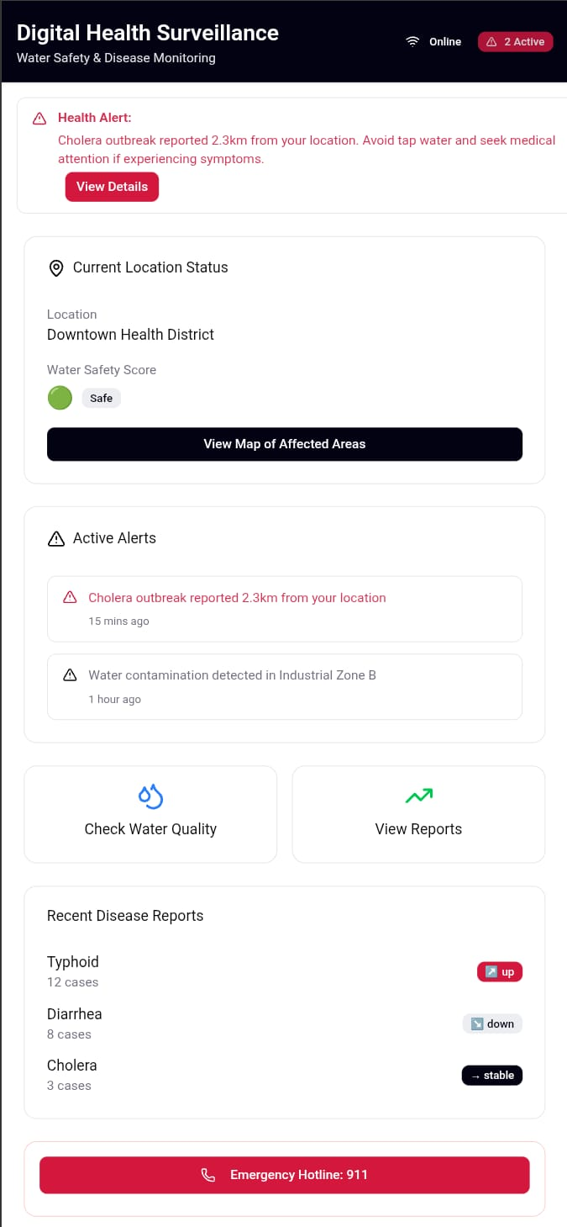
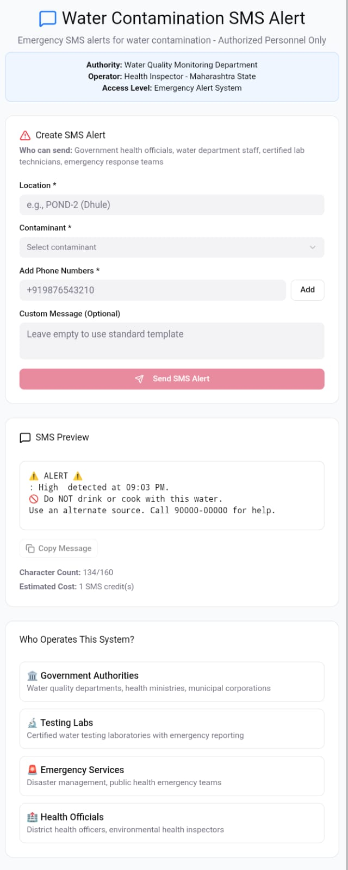
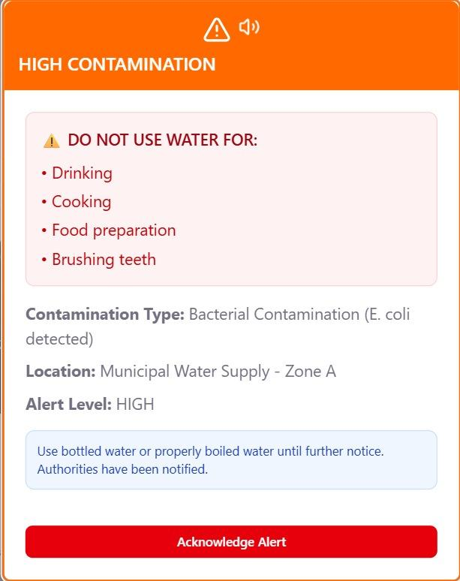
APP
SMS ALERT SYSTEM
POP UP ALERT

